Slide 1
Hexagon
Ann-Marie Czuboka (40209452)
Isabelle Czuboka (40209525)
Guillaume Lachapelle (40203325)
Nicholas Piperni (40207764)
Karina Sanchez-Duran (40189860)
Oliver Vilney (40214948)

Slide 2





Project Overview (Isabelle)

Slide 3
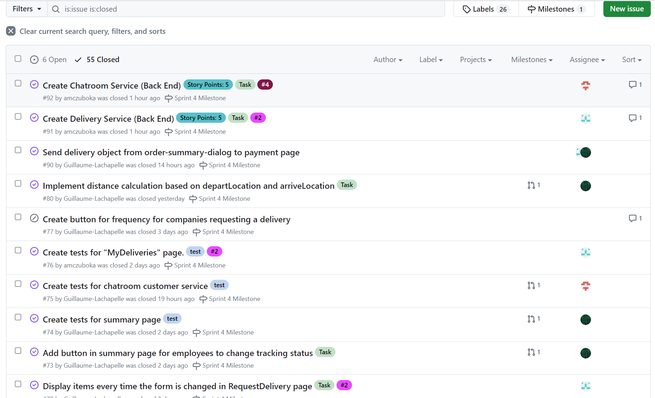
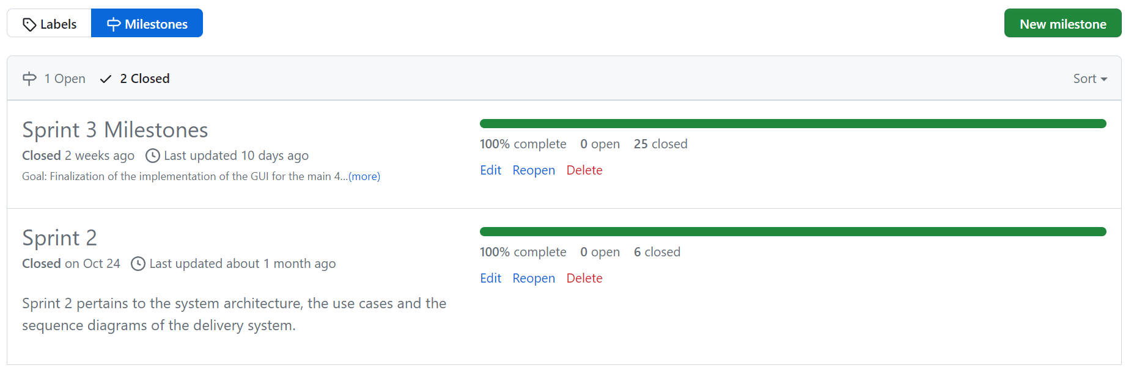
Set Up GitHub
TASKS
MILESTONES

Slide 4
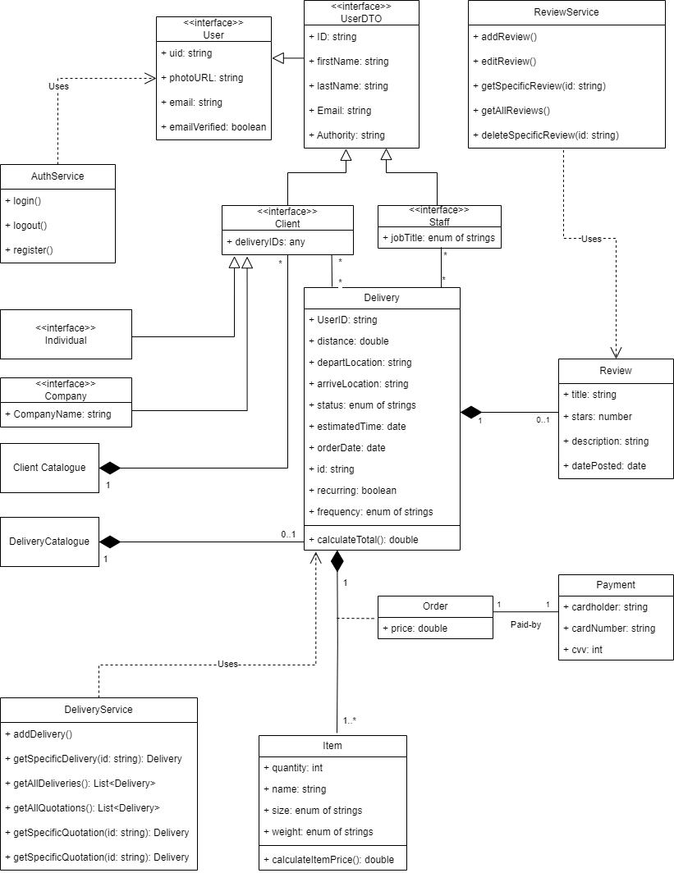
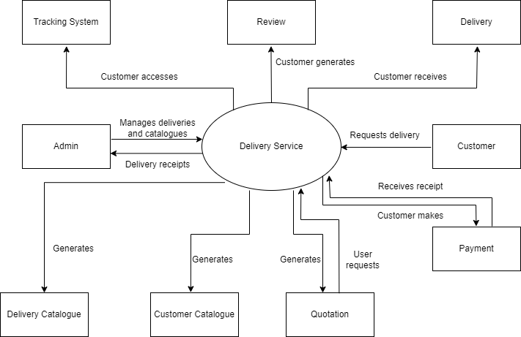
Coding through Analysis and Design
CLASS DIAGRAM
CONTEXT DIAGRAM

Slide 5
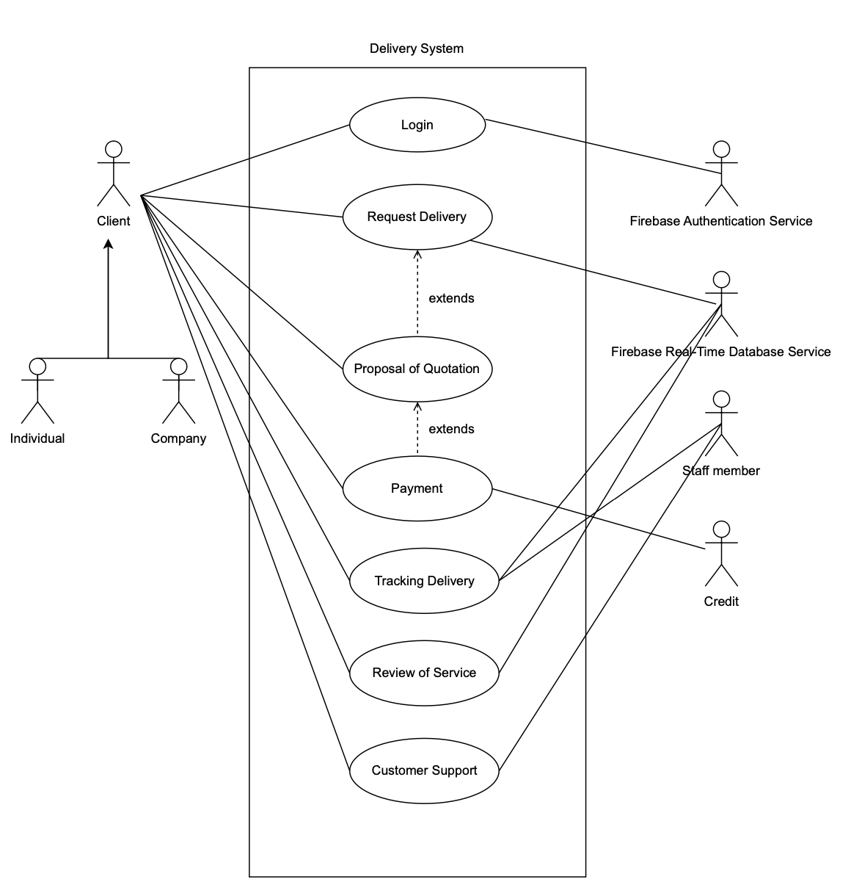
Main functionalities

Slide 6
Use Case Success Scenarios
Request Delivery
A client navigates to “request delivery or quotation” page, inputs all the required fields, then an order summary pops up and the user can proceed to payment.
A client navigates to the “my deliveries” page, clicks on a saved quotation and proceeds to payment.
Request Quotation
A client navigates to “request delivery or quotation” page, inputs all the required fields, then an order summary pops up and the user can save quotation.
Track the Delivery
A client navigates to “my deliveries” and can see the tracking status of their deliveries.

Slide 7
Use Case Success Scenarios
Make Payment
A client clicks “Proceed to Payment” from either the “request delivery or quotation” page or the “my deliveries” page and then proceeds to fill out their credit card information to complete the transaction.
Review Service
A client goes to “my deliveries” and can write a review on a delivery that is completed. The review appears under their delivery and in the review section of the website.
Request Customer Support
A client can receive customer support by asking questions in a chat room.

Slide 8
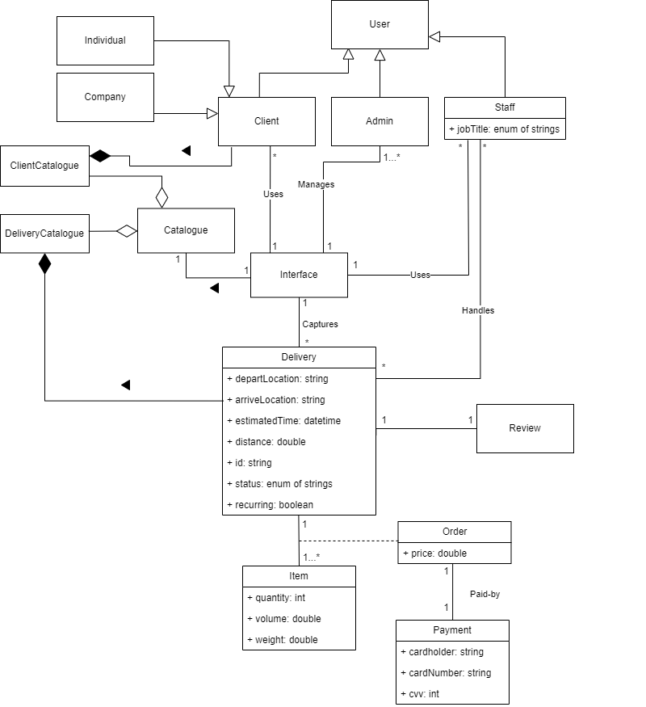
Domain Diagram vs Actual Architecture
Domain Diagram: Illustrate concepts and interactions
Actual Architecture: Illustrates the structure of the code

Slide 9
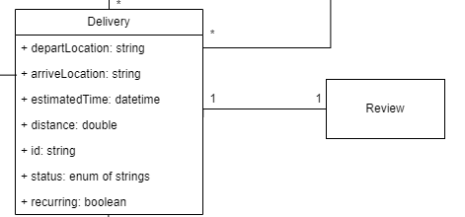
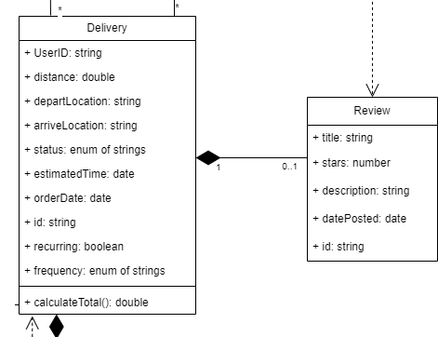
Domain Diagram vs Class Diagram
Domain Diagram contains all the domain concepts and how they are associated.
Class diagram provides more details on the attributes and methods that belong to each domain concept. Methods are taken from the sequence diagrams.

Slide 10
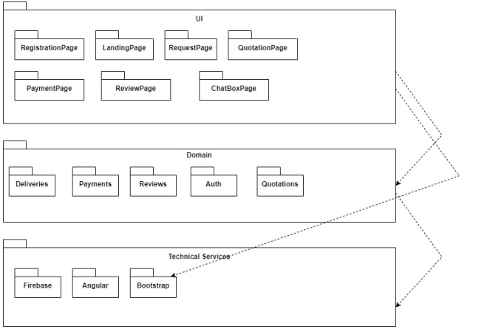

Slide 11
Refactorings and Why
Refactoring methods:
higher cohesion
lower coupling
use of controller
test passing
comprehensive comments

Slide 12
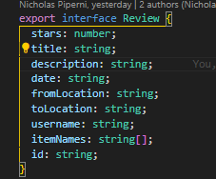
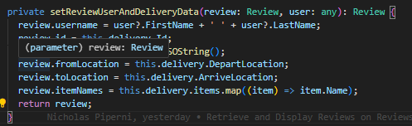
Lower coupling
takes delivery attributes (coupling)

Slide 13
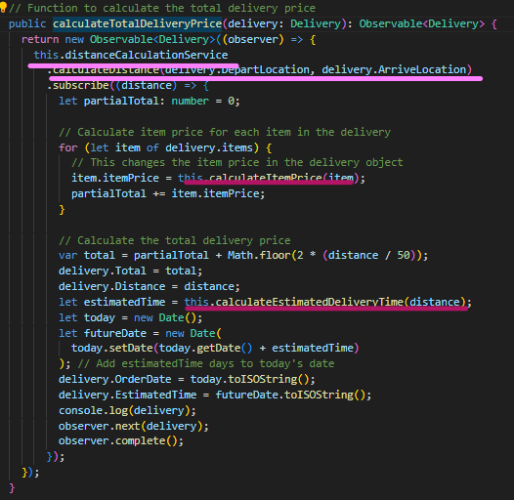
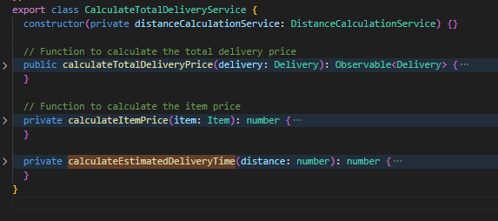
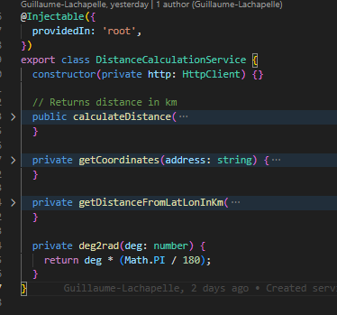
Higher cohesion
Function relevance, Module function use

Slide 14
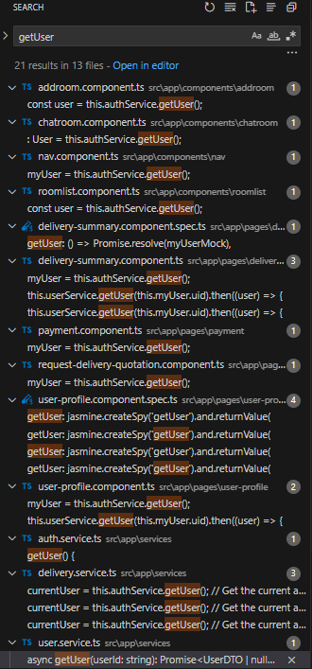
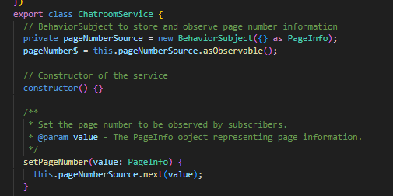
Controller: Services
Repeated functions
Events handling

Slide 15
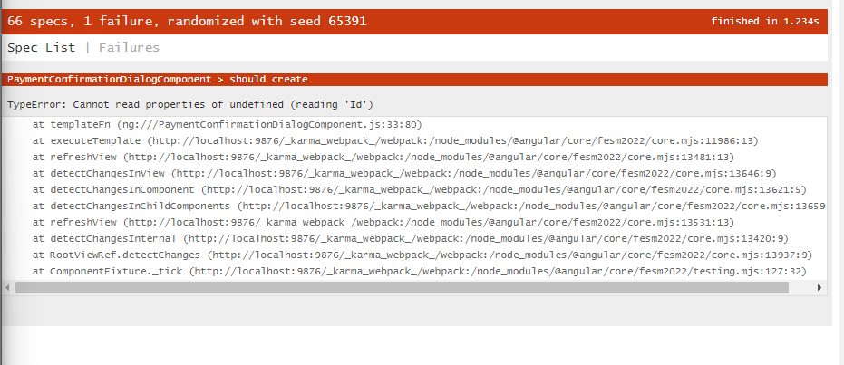
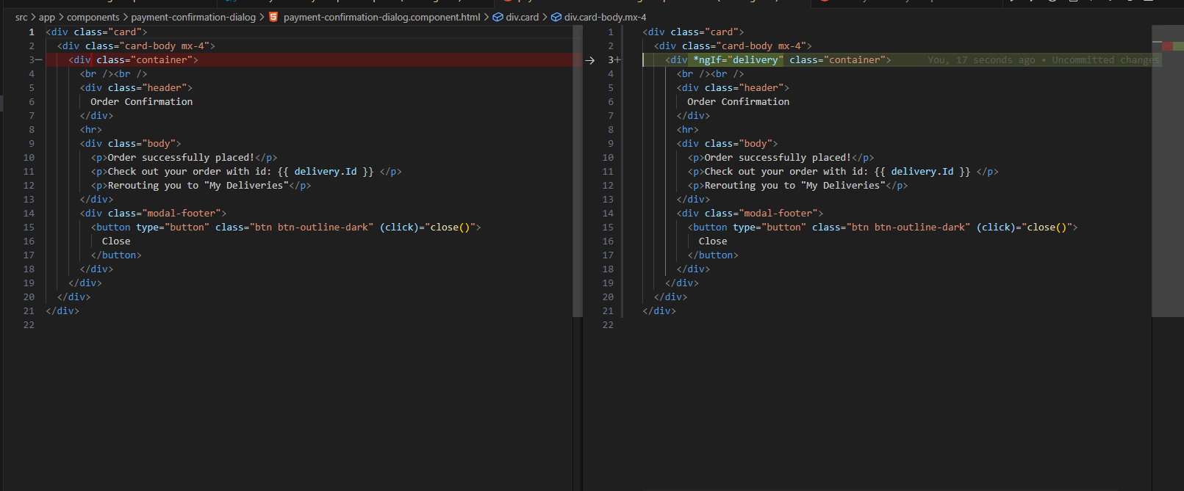
Test

Slide 16
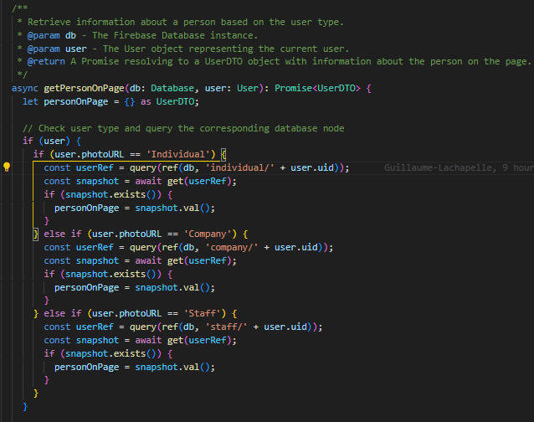
Comprehensive comments
clear comments depending on complexity

Slide 17
Demo
6 Core features
Request for delivery (details of pick up and drop off)
Proposal of a quotation for the service
Communication about the service
Tracking the order
Payment
Review of service

Slide 18
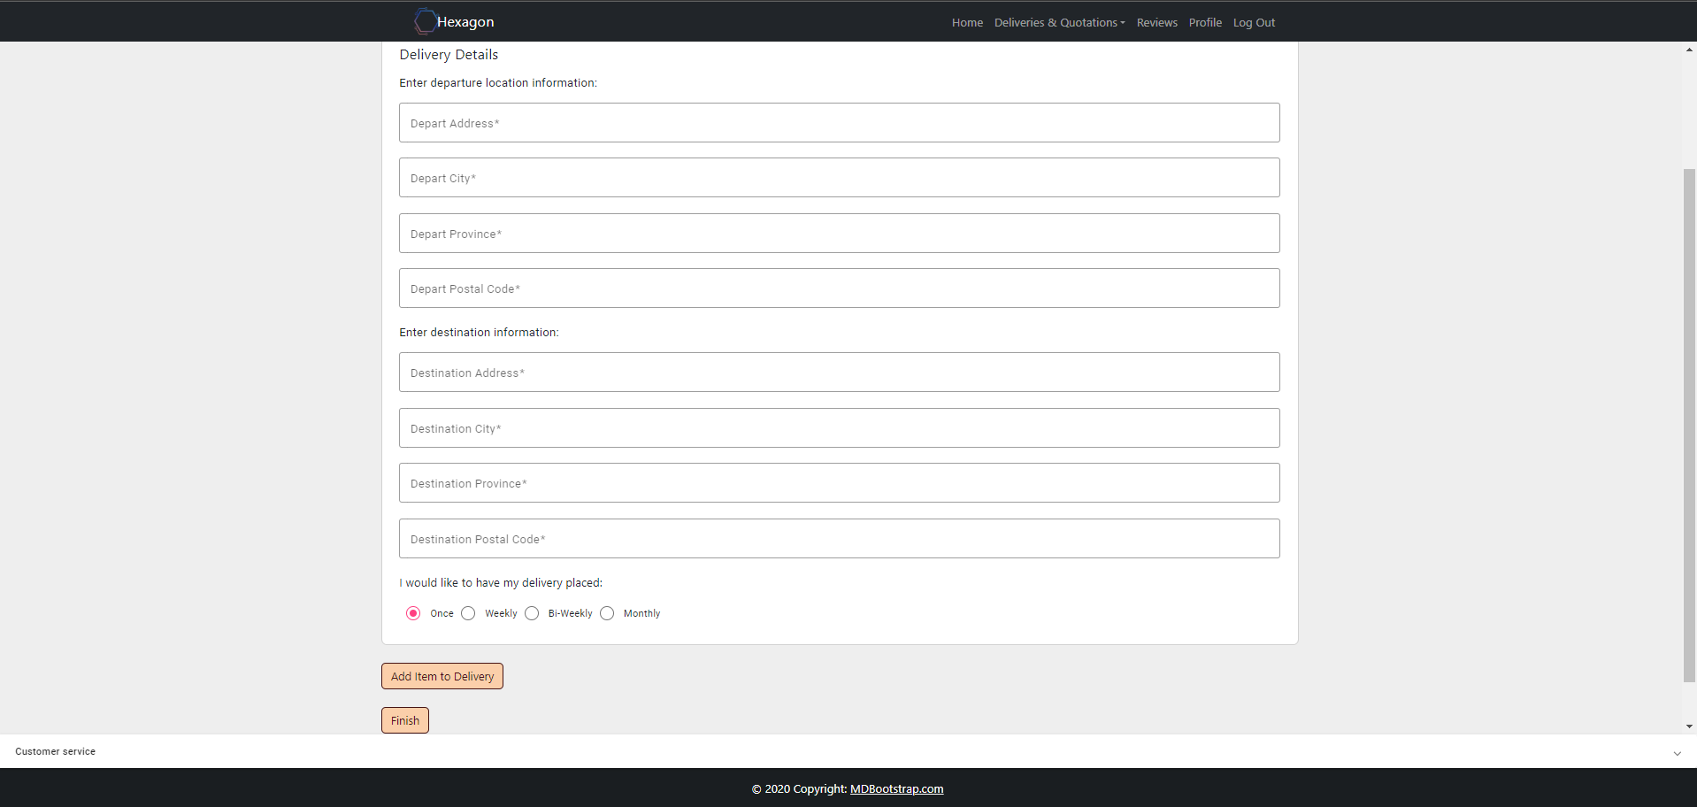
Request Delivery

Slide 19
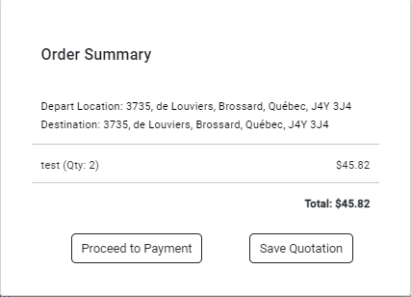
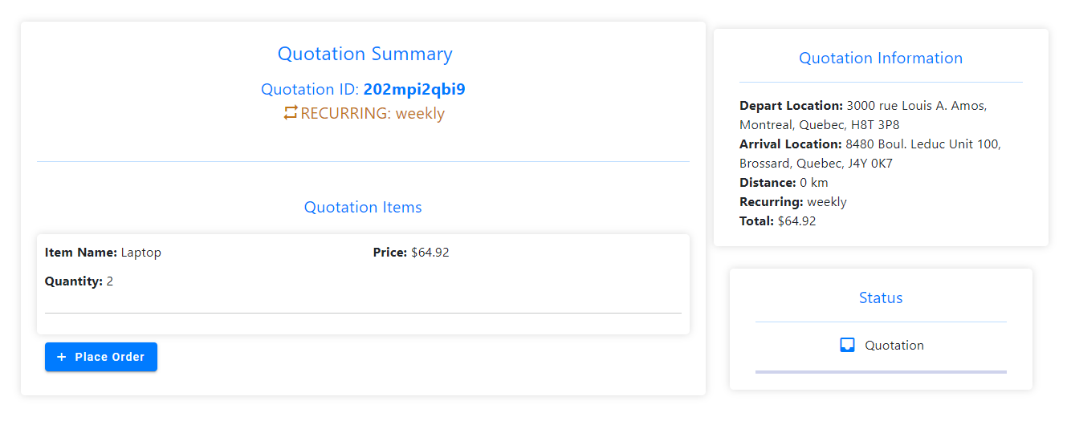
Proposal of quotation

Slide 20
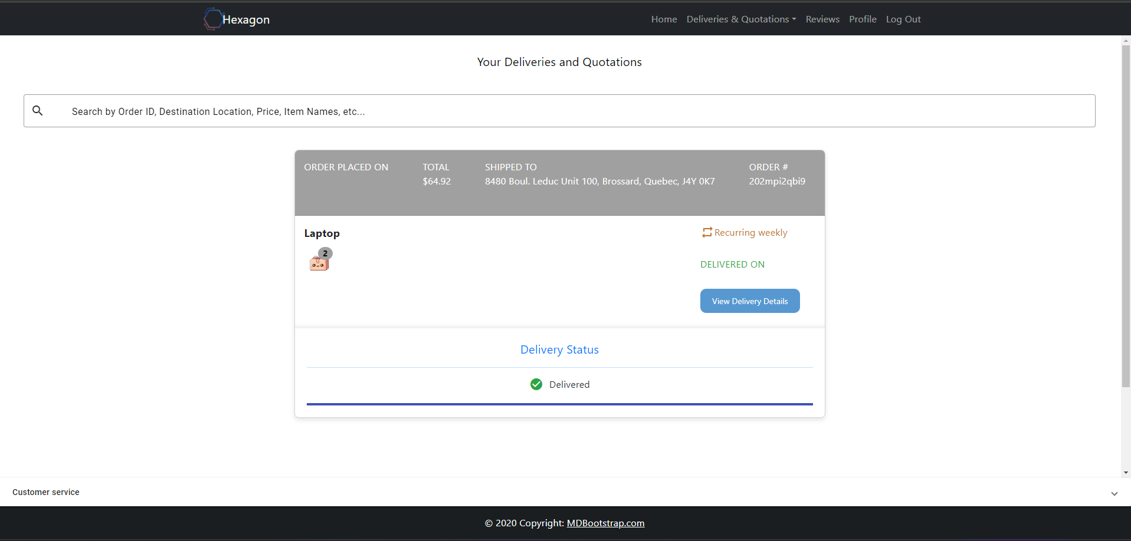
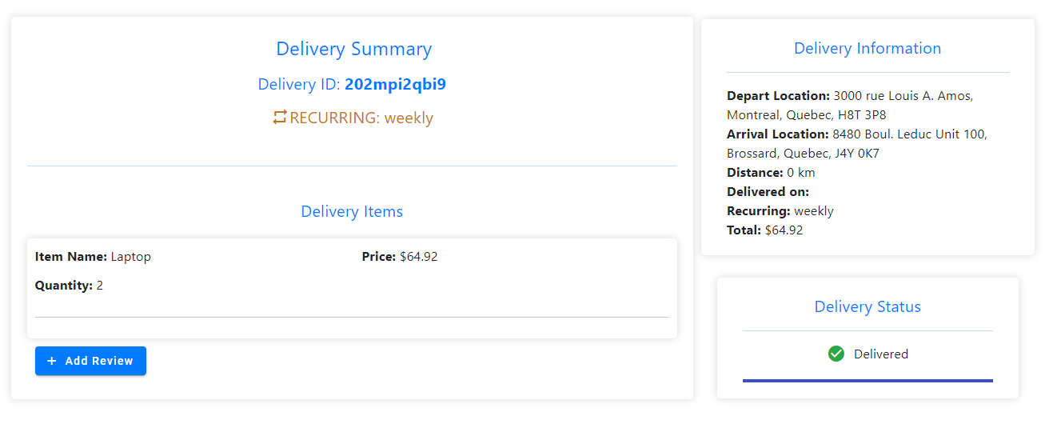
Tracking the order

Slide 21
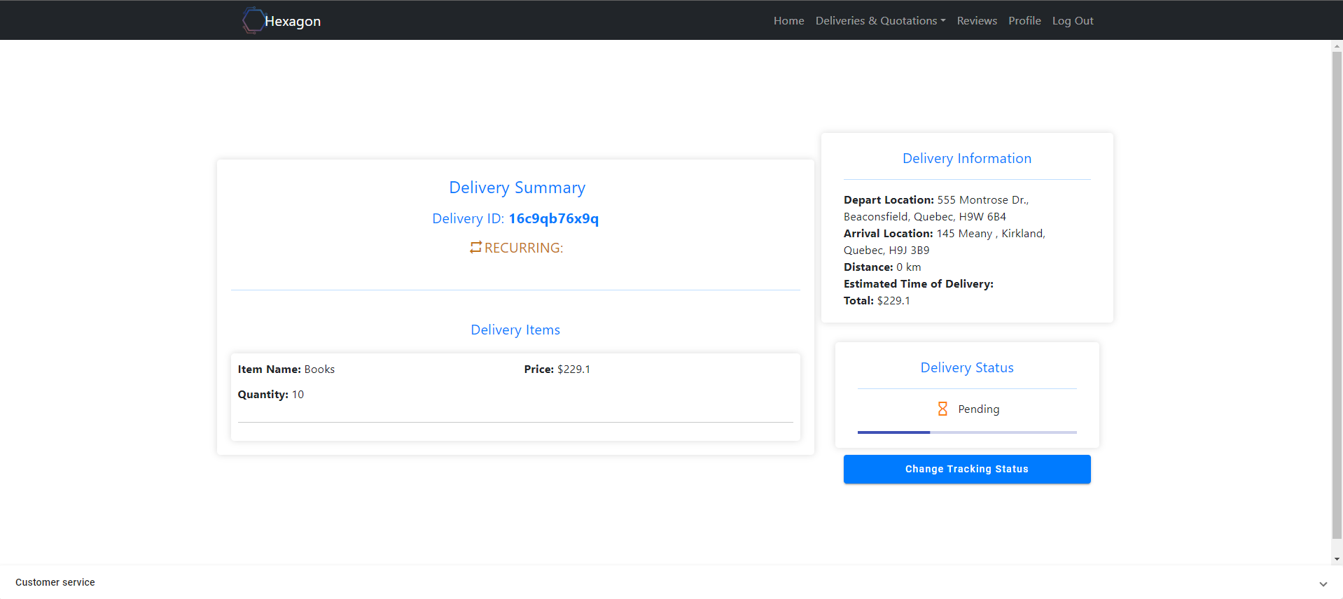
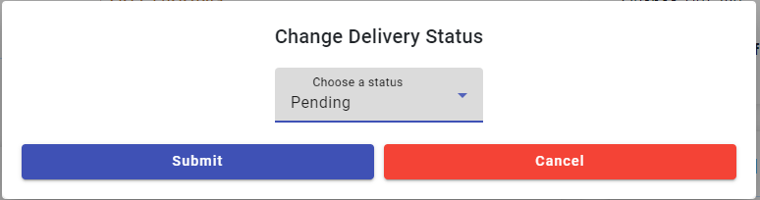
Tracking status (staff)

Slide 22
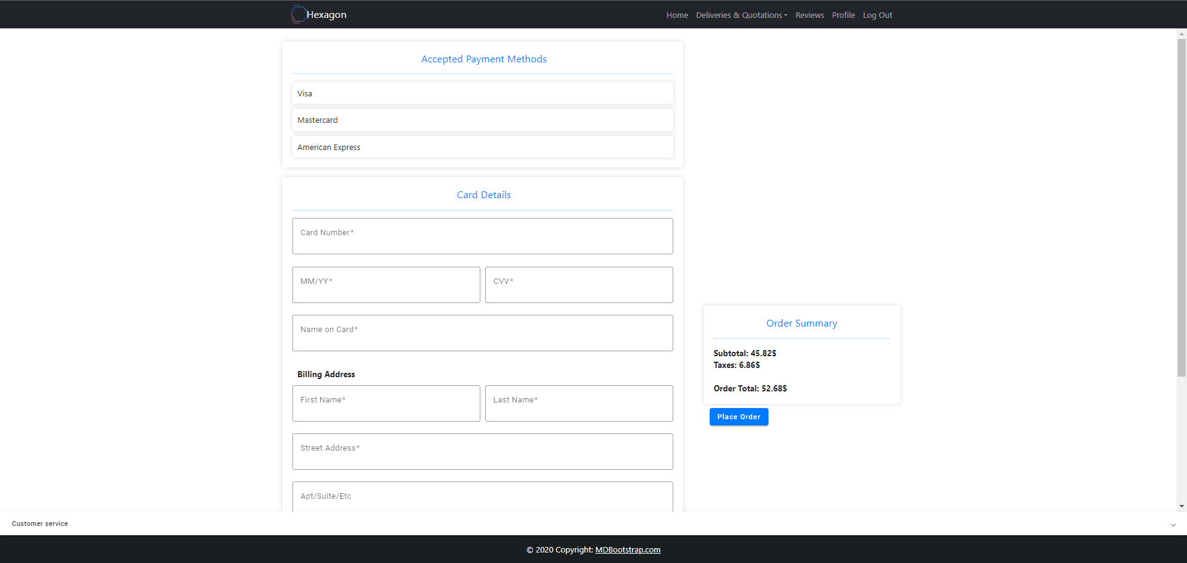
Payment

Slide 23
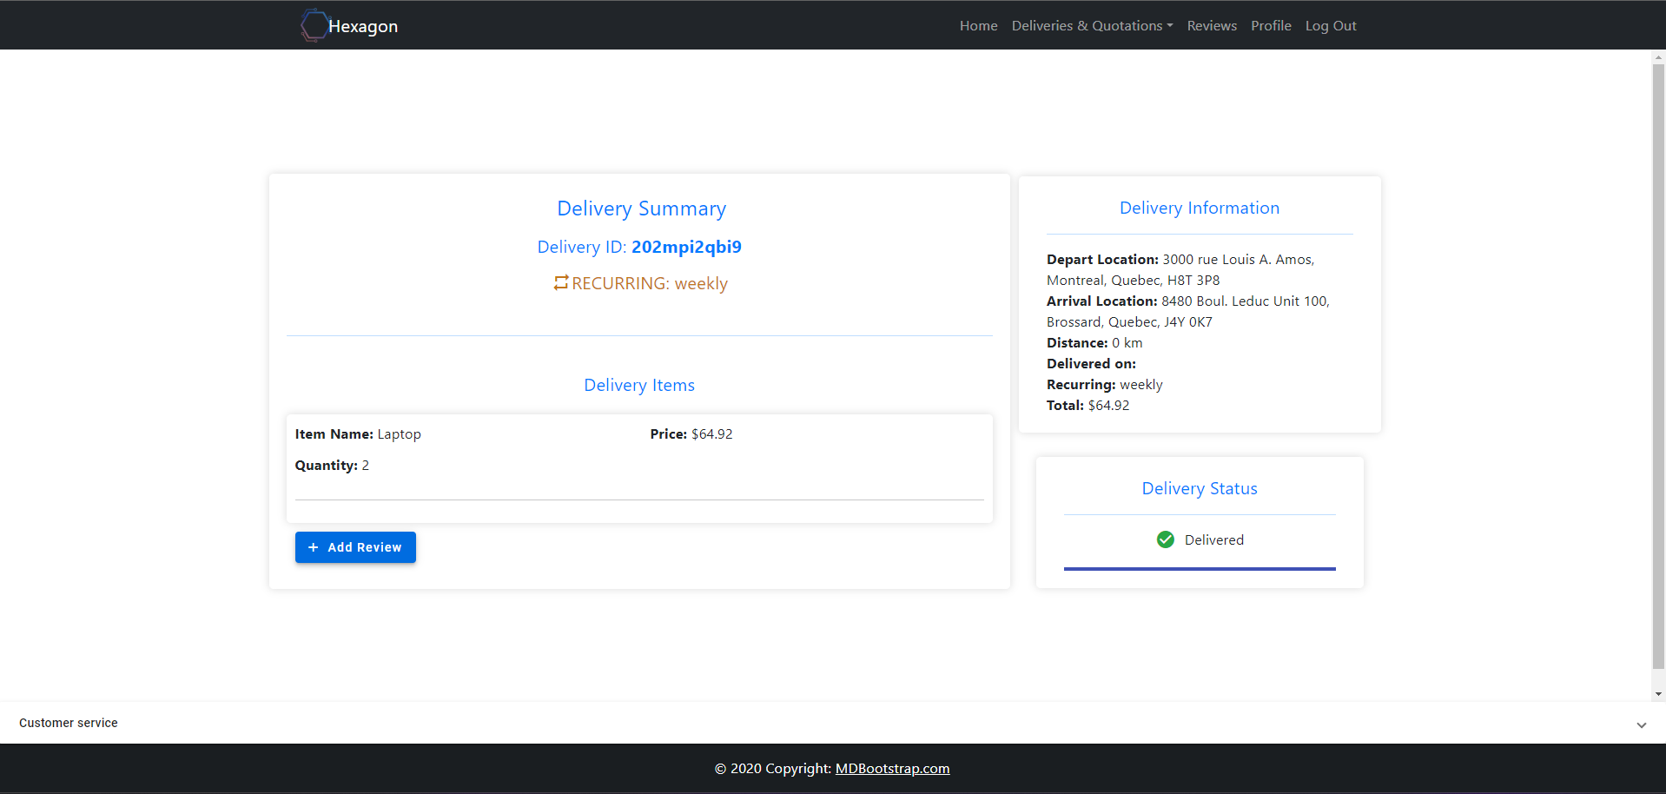
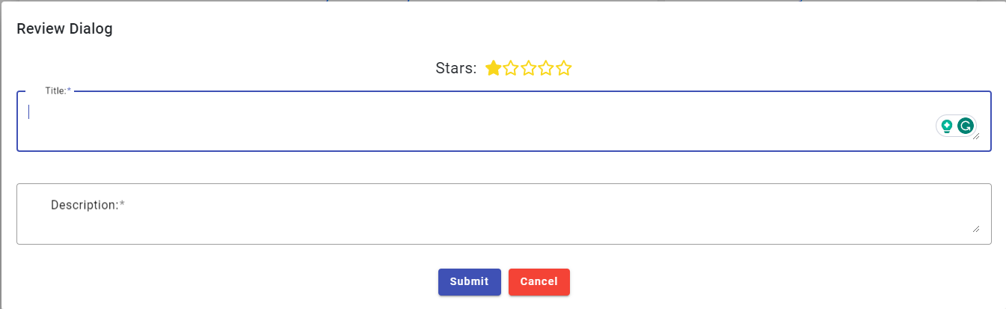
Review

Slide 24
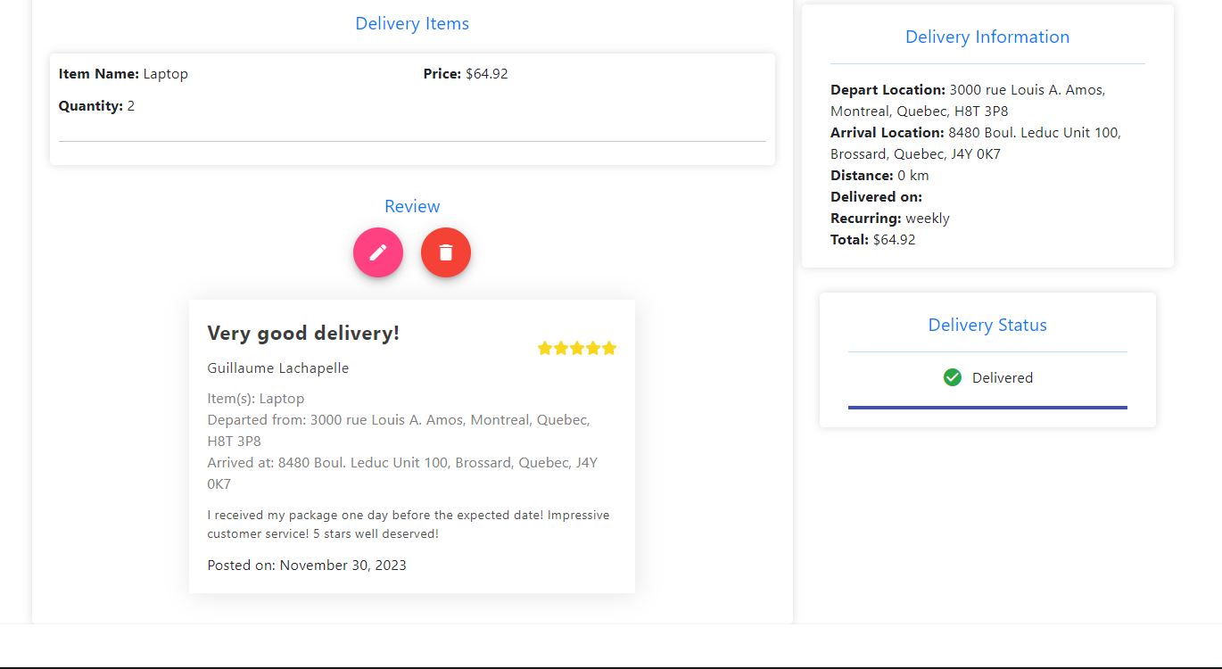
Review (cont’d)

Slide 25
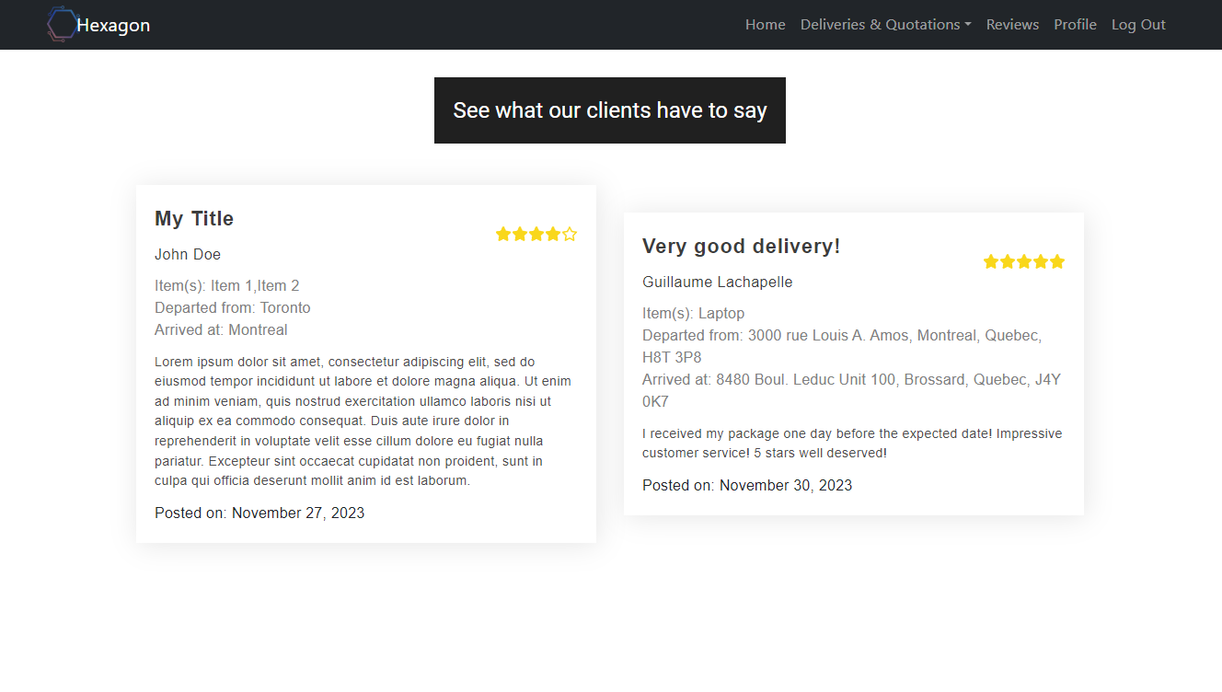
Review page

Slide 26
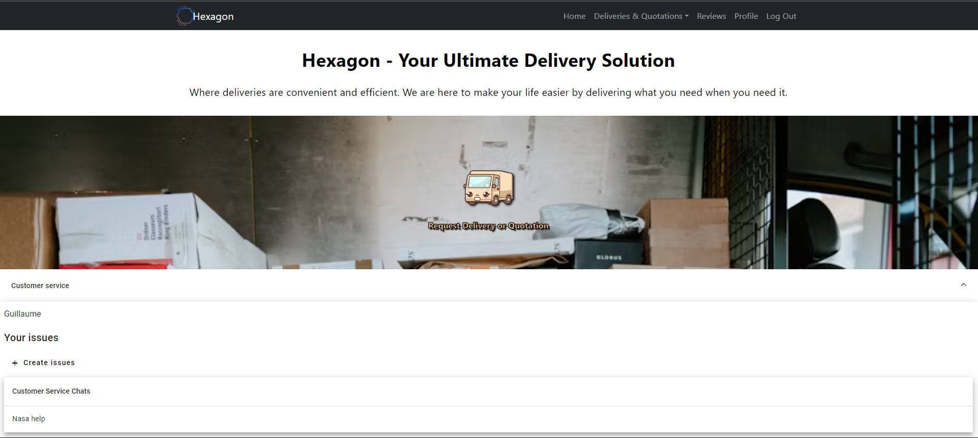
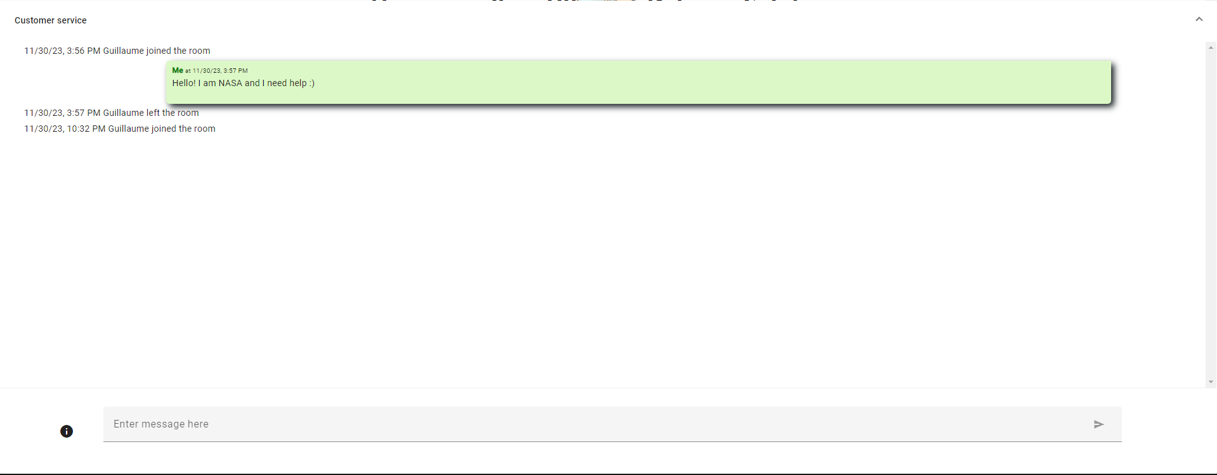
Communication about service

Slide 27
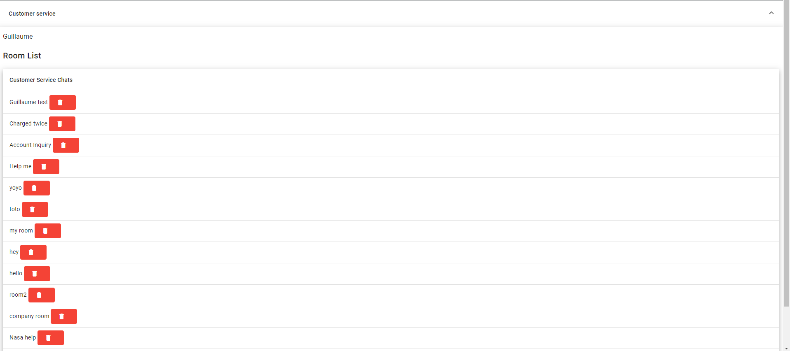
Communication (staff)

Slide 28


Conclusion
What did we learn??
Notes:
Link for image: imgres

Slide 29
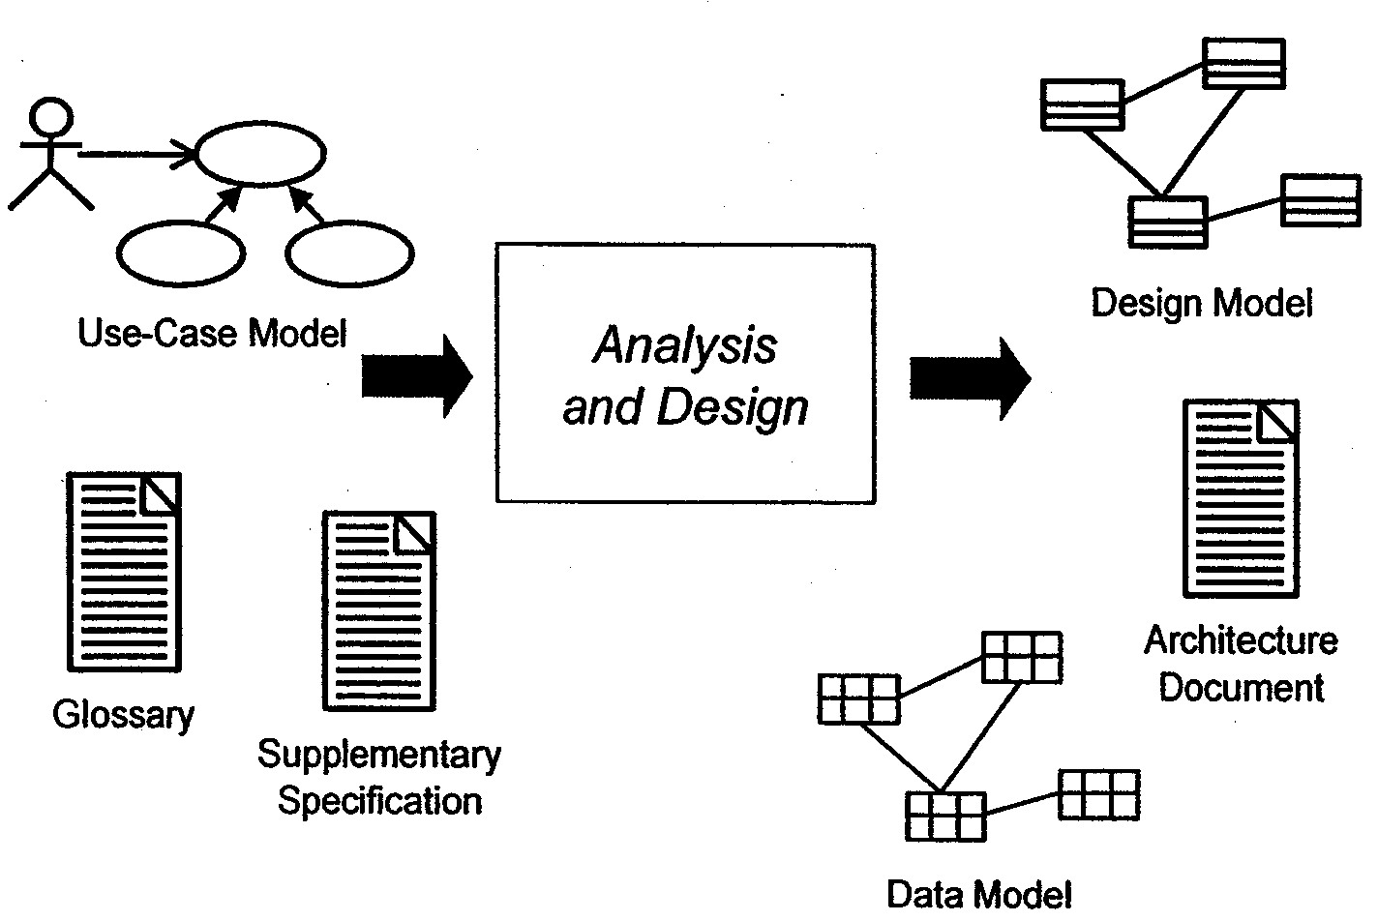
Analysis and Design
Notes:
Link for image: 1,424 × 952

Slide 30
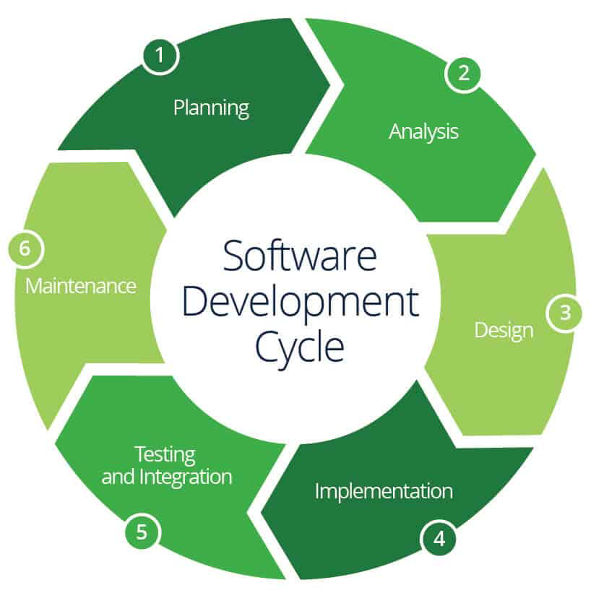
Lifecycle of Project
Notes:
Link to image: 818 × 828

Slide 31

Thank you
Notes:
Link for image: imgres

